Slide 1


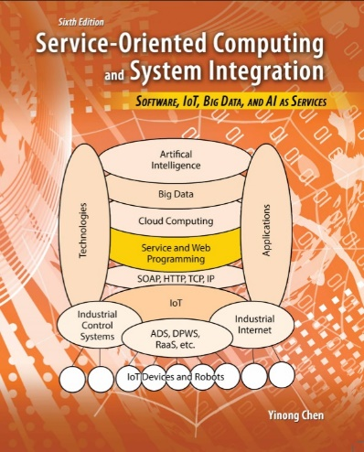
CSE 446 Software Integration and Engineering
Unit 2 Software Development by Composition and Integration
Lecture 2-1
Enterprise Architecture and Business Process
Dr. Y. Chen
https://myasucourses.asu.edu/

Slide 2
Unit 2 Outline
Software Development by Composition and Integration
2-1
2-2
2-3
Enterprise Architecture and Business Process
Workflow Foundation 1: Concepts
Workflow Foundation 2: Case Study
BPEL (Business Process Execution Language)
WSDL in BPEL
BPEL constructs and BPEL Process Definition
A Case Study of BPEL Application
Stateful Services
Development Frameworks Supporting BPEL
Oracle SOA Suite, BPMN, and BizTalk
2-4
Unit 2 Test
2-5
2-6
2-7
Message-Based Integration
Web Caching and Recommendation
Mid-Term Exam
2-8

Slide 3
Software Engineers and CS Occupations (There are many more) in U.S. DoL Occupational Outlook Handbook
Why do you want to be a Software Architect?
http://www.bls.gov/ooh/
Occupational title | Employment in 2008 | Employment in 2018 | Change in number | Change in percentage
Software engineers / Software Architect | 909,600 | 1,204,800 | 295,200 | 32
Computer systems analysts | 532,200 | 640,300 | 108,100 | 20
Computer network, systems, and database administrators | 961,200 | 1,247,800 | 286,600 | 30
Computer programmers | 426,700 | 414,400 | -12,300 | -3
Computer support specialists | 565,700 | 643,700 | 78,000 | 14
Computer and information systems managers | 293,000 | 342,500 | 49,500 | 17
IT Jobs: 4,875,600.00 (78%)
All other eng. jobs: 1,368,200.00 (22%)

Slide 4

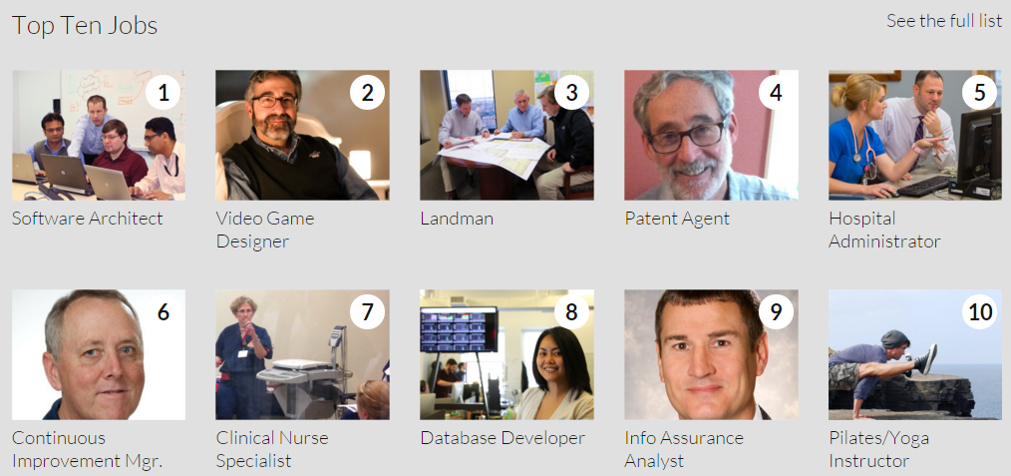
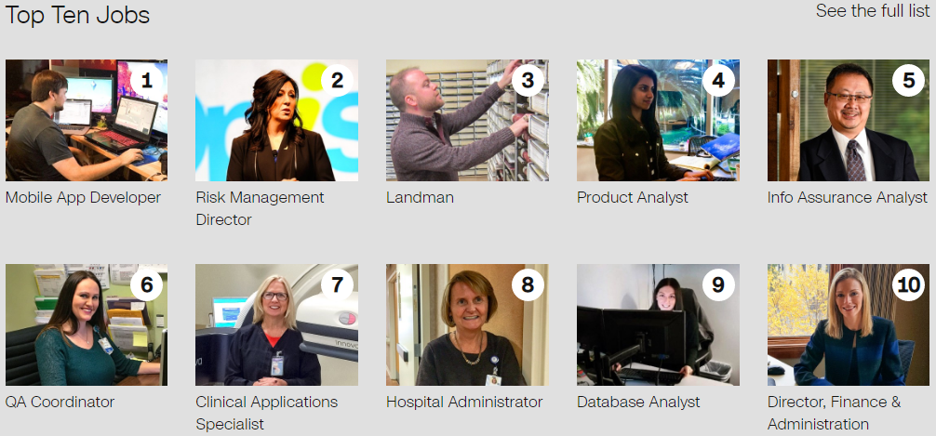
Why do you want to be a Software Architect?
http://money.cnn.com/pf/best-jobs/
2015
In top 50:
17 IT Program Manager
32 Software Quality Assurance Manager
38 IT Security Consultant
2017
In top 50:
13 Information Tech Director
14 Webmaster
22 IT Operations Manager
33 Video game designer
35 IT Training Specialist
38 IT Business Analyst
50 IT Security Director
How do you become a Software Architect?

Slide 5
Lecture 2-1 Outline
Architecture-Level Integration
How do you become a Software Architect?
Enterprise Architecture and Business Process
Business and Technology Interaction
Enterprise Architecture Integration (EAI)
Enterprise Architecture Framework (EAF)
Business Process Management (BPM)
Development Life Cycle
Dynamic Application Architecture for Dynamic Business

Slide 6
eBusiness and Technology Interaction
On Demand e-business
with AI-based real-time reconfigure-ation, resilient, & automated evolution
User-provided contents, Dynamic discovery,
Social networking, Social integration
e-business
Enterprise level collaboration & integration, Dynamic business composition, EAI, BPM
Core business on Web with database and Web-enabled execution of business process and transaction.
Maintain a multi page Web site; Use Web-form and Web-email for data exchange with clients
Computerized establishment of e-business with basic information exchange with clients
Early stage of Internet:
Email
FTP
Static Web 1.0 with HTML forms and email support
Web-based computing model and Web database integration
Web 2.0, Web 3.0, SOA, SOC, SOD, ESB, Dynamic application architecture
Web 4.0, HTML5, REST services, Cloud computing, Big Data, Social computing and networking platforms
Web 5.0 with proactive artificial intelligent services and applications
Technology
80s
90s
00-04
05-09
10-14
15-20

Slide 7
Enterprise Architecture Integration (EAI)
Enterprise level collaboration & integration, Dynamic business composition, EAI, BPM
Architecture: The fundamental organization of a system, its components, and the relationships among the components;
Enterprise Architecture: An architecture of a system involves the one or more enterprises, including their business processes, data and information, as well as the technologies;
Enterprise Architecture Integration (EAI): Seamless integration of architectures, business processes, data and information, as well as the infrastructure / technologies within an enterprise and across enterprises.

Slide 8

Purposes of EAI
Architecture Integration: Defining architecture framework for managing the development and maintenance of architecture descriptions.
Data (information) Integrity: Ensuring that information in multiple systems is kept consistent.
Application Integration: Different applications can communicate with each other, and are ready for integration
Vendor Independence: If a business application is replaced with a different vendor's application, the business rules do not have to be re-implemented.
Common Facade: An EAI system could be a cluster of different applications. It can provide a single consistent access interface to these applications and shielding users from having to learn to interact with different software packages.

Slide 9
Enterprise Architecture Integration
Enterprise Application Integration (EAI) composed of a collection of technologies and services.
A middleware to enable integration of systems and applications within and across the enterprises.
Examples
Supply chain management applications (for managing inventory, shipping, and interaction with other enterprises);
Customer relationship management applications (for managing current and potential customers);
Business intelligence applications (for finding patterns from existing data generated from operations). Big data is a major tool for today’s business intelligence applications.

Slide 10

Enterprise Architecture Framework (EAF)
EAF jobs
Enterprise Architecture Framework (EAF) is a standard developed by the U.S. NIST, dealing with architecture integration.
EAF is an organizing mechanism for managing the development and maintenance of architecture descriptions.
EAF provides a structure for organizing resources and describing related activities.
EAF follows Enterprise Architecture Model (EAM)
The other layers of integration in EAM (data, application, and infrastructure) will be discussed in the following lectures

Slide 11
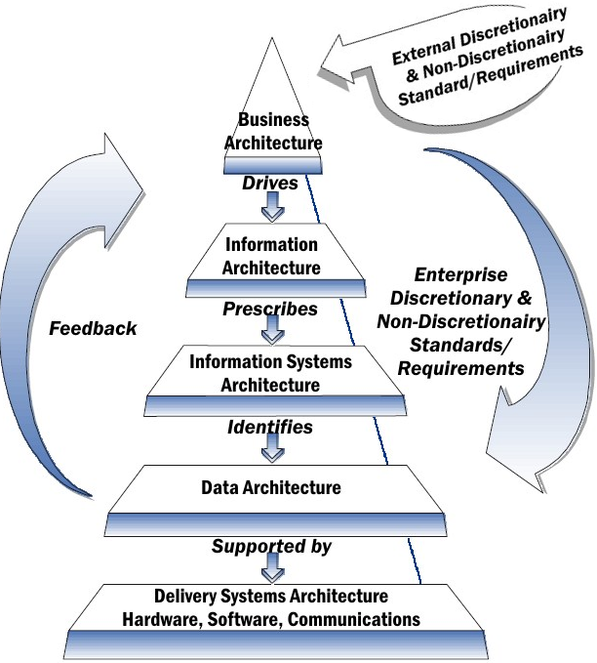
National Institute of Standards and Technology (NIST) Enterprise Architecture Model (EAM)
https://en.wikipedia.org/wiki/NIST_Enterprise_Architecture_Model
EAM jobs
Infrastructure

Slide 12
Federal Enterprise Architecture Framework (FEAF)
https://obamawhitehouse.archives.gov/sites/default/files/omb/assets/egov_docs/fea_v2.pdf 2013
Developed by The Chief Information Officers Council
Follow the NIST Enterprise Architecture Model
Purposes of developing this framework:
Organize Federal information and promote Federal interoperability;
Promote information sharing among Federal organizations;
Help Federal organizations developing their architectures;
Help Federal organizations quickly developing their IT investment processes;
Serve customer needs better, faster, and more cost effectively;
Provide potential for Federal and Agency to reduce costs.

Slide 13
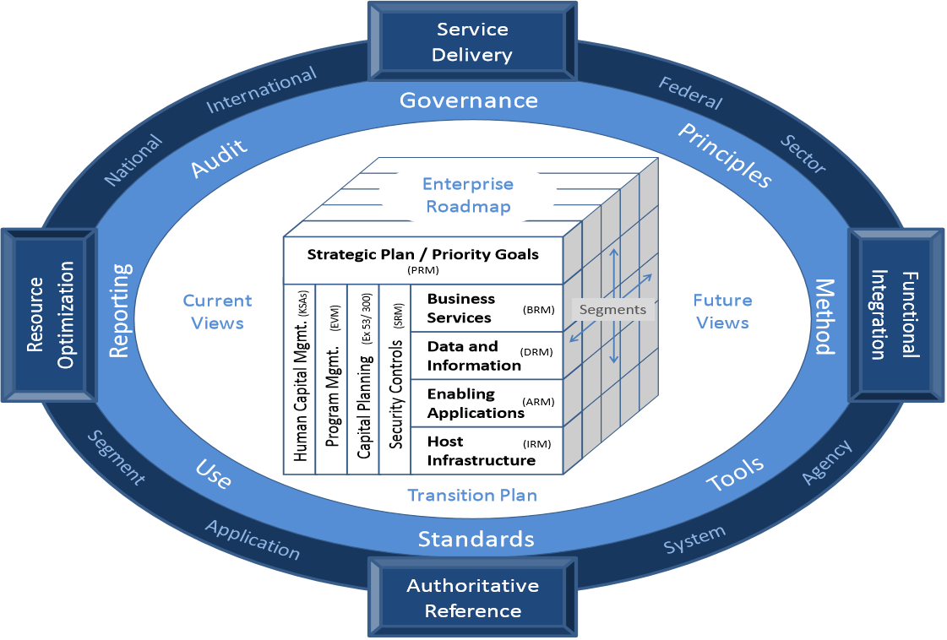
Federal Enterprise Architecture Framework (FEAF)
Organization

Slide 14
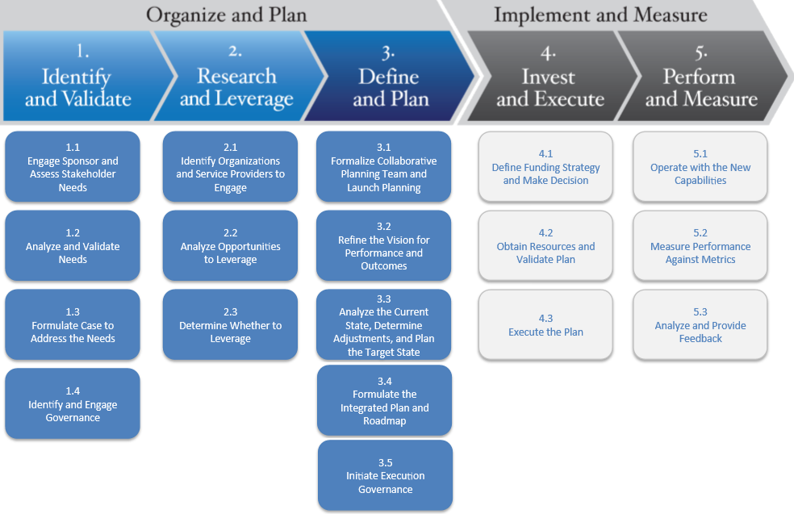
Federal Enterprise Architecture Framework (FEAF)
Development

Slide 15
Eight Key Components of the FEAF
Architecture Drivers: business and design stimuli
Current Architecture (View): the "as is" enterprise architecture
Future Architecture (View): the "to-be-built" enterprise architecture
Strategic Direction – Overall guidelines to the development from current architecture to the target architecture
Transition Plan – Concrete support to the migration from the current to the target architecture
Architectural Segments - Enterprises within the total Federal Enterprise.
Architectural Models - business and design models that describe the segments of the enterprise
Standards - All standards and references (some of which may be mandatory), and best practices
1
4
2
3
Strategic Direction
Architecture Drivers
Architectural Models
Architectural Segments
6
7
5
8

Slide 16
FEAF Level I View (from 20,000 feet)
The eight components needed for developing and maintaining the Federal Enterprise Architecture
1
4
2
3
Architecture Drivers
Strategic Direction
Architectural Segments
Architectural Models
6
7
5
8

Slide 17
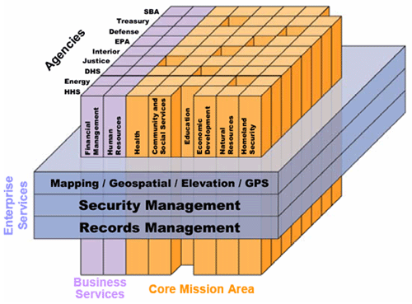
Architectural Segments in FEAF
Each architectural segment is an enterprises within the total Federal Enterprise.
Common services cross enterprises
Architectural Segments
6

Slide 18
FEAF Level II View (from 10,000 feet)
The business and design pieces of the Federal Enterprise Architecture and how they are related
1
4
Business Drivers
2
3
Vision
Strategic Direction
Principles
Architectural Segments
Business Architecture
Design Drivers
6
7
Design Architecture
5
8

Slide 19
FEAF Level III View (from 5,000 feet)
Expand design pieces of the framework to show the three design architectures: data, applications, & infrastructure
Vision
Strategic Direction
Principles
Business Drivers
Business Service
Data and Information
Enabling Applications
Host Infrastructure
Design Drivers
6 Architectural Segments

Slide 20
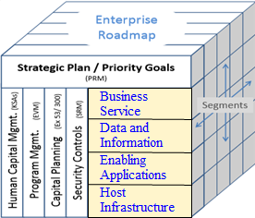
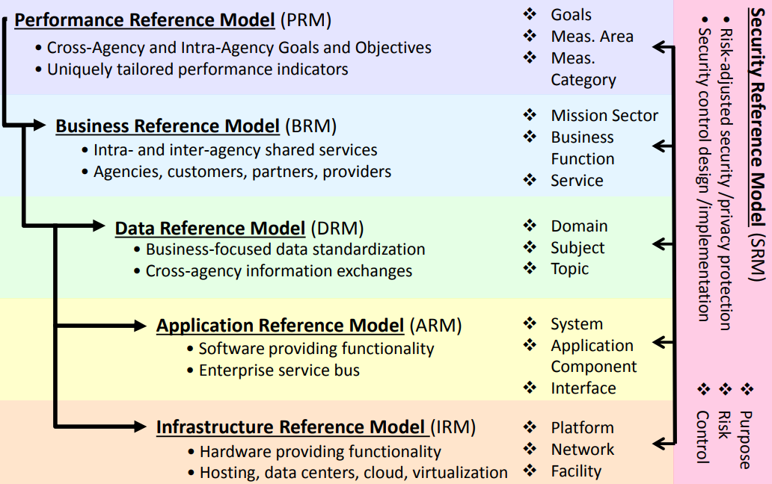
Architecture Standards and Reference Models

Slide 21
FEAF Level IV View (from 500 feet)
How is the business architecture supported by the three design architectures based on architecture reference models?
Zachman Model: IBM Systems Journal 1987 article: "A Framework for Information Systems Architecture":
It is a model for bridging the business archiecture to the design models.
The cost involved and the success of the business depend increasingly on its information systems, and a disciplined approach to the management of those systems is required.
Architecture framework is simply a logical structure for classifying and organizing the descriptive representations of an enterprise that are significant to the management of the enterprise, as well as to the development of the enterprise's systems.

Slide 22
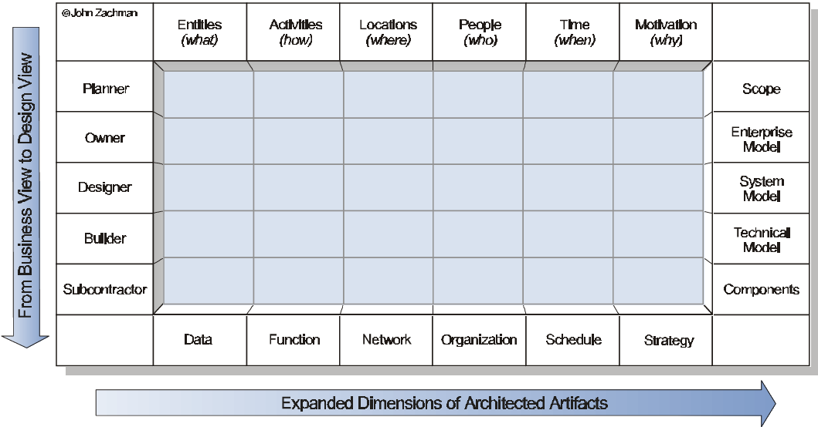
FEAF Level IV View Based on Zachman Model
The Framework enables communication among the various participants involved in developing or changing the structure

Slide 23
From Zachman Model to EAP
The Zachman Model tells what need to be done, how, where, when, why, and by whom.
It categorizes and organizes the artifacts: data, function, network, organization, schedule, and strategy.
Enterprise Architecture Planning (EAP), proposed by Dr. Steven Spewak,
defines the process of completing Zachman model;
focuses on defining what data, applications, and technology architectures are appropriate for supporting the overall enterprise.

Slide 24
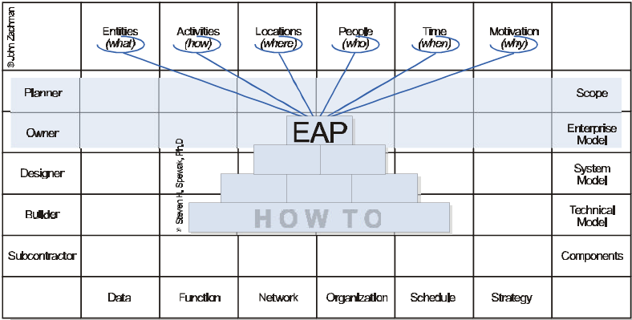
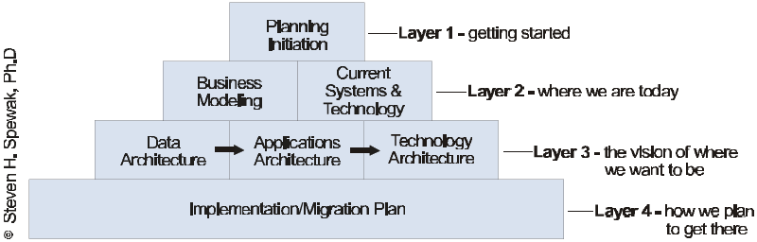
Enterprise Architecture Planning (EAP)

Slide 25
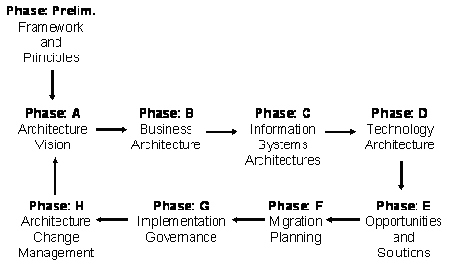
Open Group Architecture Framework (TOGAF)
TOGAF describes another architectural process;
It elaborates Zachman model. Zachman tells you how to categorize your artifacts. TOGAF gives you a process for creating them;

Slide 26
BPM: Business Process Management
http://en.wikipedia.org/wiki/Business_process_management
is an EAI technology at the design/process level;
is a management approach focusing on aligning all aspects of an organization with the wants and needs of clients;
allows organizations to abstract business process from technology infrastructure;
goes beyond automating business processes or solving business problems using software;
enables business to respond to changing consumer, market, and regulatory demands faster than competitors - creating a competitive advantage.

Slide 27
BPM Lifecycle (Before Service Orientation)
Process Design: encompasses both the identification of existing processes and the design of "to-be" processes.
Modeling: takes the theoretical design and introduces combinations (relationships) of variables or parameters;
Execution: develops an application that executes the required steps of the process;
Monitoring: tracks processes and statistics on the performance of one or more processes;
Optimization: retrieves information from modeling or monitoring phase; identifying the potential or actual bottlenecks and the potential opportunities for cost savings or other improvements; and then, applying those enhancements in the design of the process.

Slide 28
BPM Suite (BPMS) Development Framework
BPM Suite contains four critical components
Process Engine – a robust platform for modeling & executing process-based applications and business rules;
Business Analytics — enables managers to identify; business issues, trends, and opportunities with reports and dashboards and react accordingly;
Content Management — provides a system for storing & securing documents, images, and other files;
Collaboration Tools — removes intra- and interdepartmental communication barriers through discussion forums, dynamic workspaces, and message boards.

Slide 29
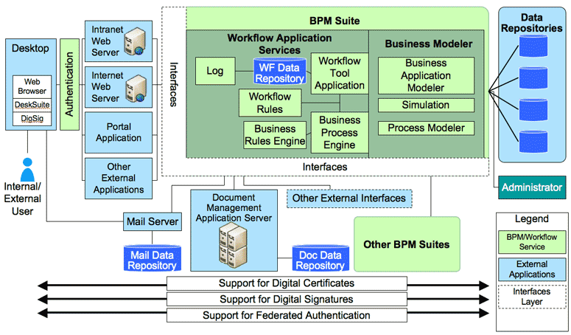
BPM Suite and Its Implementing a Business Process
http://en.wikipedia.org/wiki/Business_process_management
Presentation Tier
Business Process Tier
Data Mgmt Tier

Slide 30
Service-Oriented Applications Architecture (SOAA) at the Process Level
Service Broker
Business
Applications Architecture
Data Centers
Service Providers
ESB
Cloud Computing

Slide 31
Extended Service Broker with Applications Templates and Other items
Application Architecture
Application Builder

Slide 32
Extended Broker
Publish application template/workflow;
Publish architecture templates;
Publish collaboration templates;
Publish SOAP services with collaboration templates;
Publish data and information services (RESTful services)
Publish test scripts
Publish user interfaces
Publish Data: a typical example is Data-Centric SOA (DCSOA) and data center in cloud computing
Help in application architecture design

Slide 33
Service-Oriented Application Architecture
Dynamic Reconfigurable Application Architecture Organizing services in application;
Different architectures:
SAP Netweaver
Oracle SOA Suite
IBM ESB
Web 2.0, Web 3.0, SOA, SOC, SOD, ESB,
Dynamic application architecture

Slide 34
General Service-Oriented Application Architecture
Control Center
Composition manager
Application configuration
Workflow specification
Composition manager specifies and controls the application composition configuration via a workflow specification.
The application composition configuration/workflow specification defines how the services shall be connected together to deliver the desired application and how the messages are transferred among the services

Slide 35
Static vs. Dynamic Architecture
Static architecture with integrated components
Configuration 1
Control Center
Composition manager
Configuration 2
Application configuration
Workflow specification
Configuration 3
Workflow Editor

Slide 36
Lifecycle Reference Model of SOAA
Based on BPM and with additional implementation detail
Requirement
Modeling Specification
Verification
Simulation
Code generation
Assembling
Deployment
Reconfiguration
Evaluation
Validation
Operation
Monitoring

Slide 37
Lifecycle Reference Model with Dynamic Application Architecture

Slide 38
Dynamic Architecture Case Studies
SAP Netweaver
Oracle SOA Suite
IBM ESB

Slide 39
Application Architecture Development Tools
Project Name | Architecture Style | Characteristics
SAP NetWeaver | Layered architecture | Providing integration with the traditional applications, with the SOA applications on Microsoft .Net and IBM WebSphere platforms
Oracle Dynamic Business Process | Visual architecture in workflow | Separate architecture from business process; allowing dynamically revising architecture and process on the fly.
IBM WebSphere Reference Architecture | Layered Architecture | Merging the SOA application development and the SOA application operation into one single infrastructure based on ESB
Microsoft Workflow Foundation | Visual architecture in workflow | Aiming at providing an integrated platform for specifying architecture, modeling, code generation, and execution of SOA applications

Slide 40
SAP NetWeaver
Proposes a concept "Enterprise Services Architecture" (ESA), which provides an architecture framework for process modeling and service applications;
Provides integration with the traditional applications, such as SAP R/3 and mySAP, with the SOA applications on J2EE, Microsoft .Net, and IBM WebSphere platforms;
Provides interoperability and integration with other applications by following standards established by W3C.

Slide 41
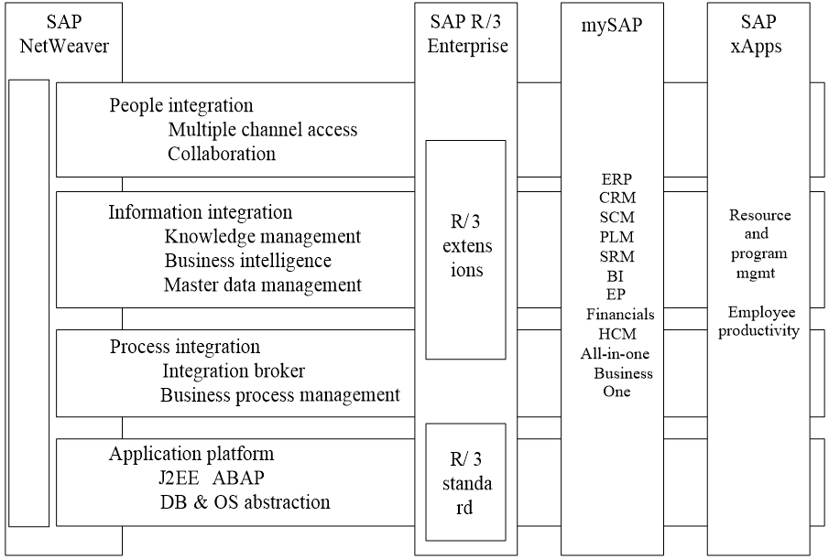
SAP NetWeaver Architecture

Slide 42
SAP NetWeaver BPM
One of the key modules in SAP Netweaver is the BPM, consisting of the following components:
Integration Builder: supports BPEL process
Integration Repository,
Integration Directory,
Business Process Engine

Slide 43
SAP BPM Supporting Dynamic Application Architecture
3. Integration
1. User modifies business process on the fly
RESTful
4. Execution
2. Modification of business process updates the integration directory

Slide 44
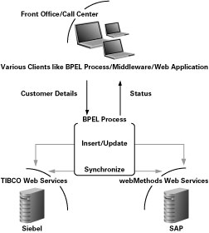
Oracle SOA Suite for BPEL
http://www.oracle.com/technetwork/articles/chandran-093340.html

Slide 45
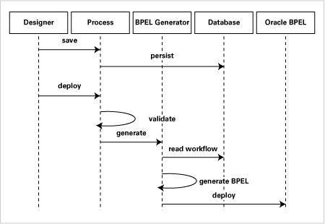
Oracle SOA Suite for Dynamic Architecture
http://www.oracle.com/technetwork/articles/thomas-087971.html

Slide 46
Oracle SOA Suite for Dynamic Architecture
An analyst uses a custom designer to graphically model the business process.
The business process definition is stored in a database.
The BPEL Generator reads and validates the process definition, and then generates the BPEL XML file from the database representation as well as associated files used for deployment.
The BPEL process is dynamically deployed on the Oracle BPEL Process Manager Server.
Just-In-Time compilation can be used to convert BPEL process to executable.

Slide 47
IBM SOA Foundation Lifecycle Model (Based on Service Oriented Computing)

Slide 48
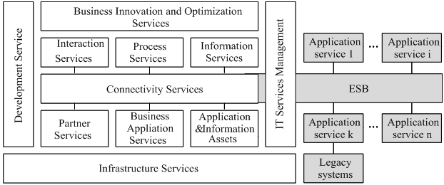
IBM SOA Foundation Lifecycle Model with its Application Architecture and ESB

Slide 49
IBM Enterprise Service Bus (ESB)
SAP Application
ESB
Translate message formats;
Adapt different interaction patterns;
Convert transport protocols;
Analyze and share the service interface;
Propagate the security content;
Provide WS-* support, including WS-RM, WS-Security, and WS-Transaction;
Track and monitor service activities
https://www-01.ibm.com/software/solutions/soa/esb.html

Slide 50
What Next? From Dynamic to On Demand Business
On Demand eBusiness
with AI-based real-time reconfig-uration, resilient & automated evolution
Dynamic Business Composition
Changing environment and changing partners
Reconfiguring business without stopping operations
Manual reconfiguration
On Demand Business with Artificial Intelligence
Proactive discovery
Responsive reconfiguration in real-time
Resilient around the world and around the clock
Automated reconfiguration
Web 5.0 with proactive artificial intelligent services and applications
2015-2020

